Slide 1
deep learning
David Kauchak
CS158 – Fall 2023

Slide 2
Admin
Assignment 8
Schedule for the rest of the semester

Slide 3

Deep learning
Deep learning is a branch of machine learning based on a set of algorithms that attempt to model high level abstractions in data by using a deep graph with multiple processing layers, composed of multiple linear and non-linear transformations.
Deep learning is part of a broader family of machine learning methods based on learning representations of data.

Slide 4
Deep learning
Key: learning better features that abstract from the “raw” data
Using learned feature representations based on large amounts of data, generally unsupervised
Using classifiers with multiple layers of learning

Slide 5

Deep learning
More abstract representation
Train multiple layers of features/abstractions from data.
Try to discover representation that makes decisions easy.
Low-level
Features
Mid-level
Features
High-level
Features
Classifier
“Cat”?
Deep Learning: train layers of features so that classifier works well.
Slide adapted from: Adam Coates

Slide 6
Deep learning for neural networks
Traditional NN models: 1-2 hidden layers
Deep learning NN models: 3+ hidden layers
…

Slide 7
Importance of features
Feature quality is critical to the performance of ML methods
Normal process = hand-crafted features
Deep learning: find algorithms to automatically discover features from the data

Slide 8
Challenges
What makes “deep learning” hard for NNs?
…

Slide 9
Challenges
What makes “deep learning” hard for NNs?
…
…
What will happened to the modified errors further up?

Slide 10
Challenges
What makes “deep learning” hard for NNs?
…
…
Modified errors tend to get diluted as they get combined with many layers of weight corrections

Slide 11
Deep learning
Growing field
Driven by:
Increase in data availability
Increase in computational power
Parallelizability of many of the algorithms
Involves more than just neural networks (though, they’re a very popular model)

Slide 12
word2vec
How many people have heard of it?
What is it?

Slide 13
Word representations
Wine data uses word occurrences as a feature
What does this miss?

Slide 14
Word representations
Wine data uses word occurrences as a feature
What does this miss?
“The wine had a dark red color” Zinfandel
“The wine was a deep crimson color” label?
“The wine was a deep yellow color” label?
Would like to recognize that words have similar meaning even though they aren’t lexically the same

Slide 15
Word representations
Key idea: project words into a multi-dimensional “meaning” space
word
[x₁, x₂, …, x_{d}]

Slide 16
Word representations
Key idea: project words into a multi-dimensional “meaning” space
word
[x₁, x₂, …, x_{d}]
red
[r₁, r₂, …, r_{d}]
[y₁, y₂, …, y_{d}]
crimson
[c₁, c₂, …, c_{d}]
[r₁, r₂, …, r_{d}]
[c₁, c₂, …, c_{d}]
yellow
[y₁, y₂, …, y_{d}]

Slide 17
Word representations
Key idea: project words into a multi-dimensional “meaning” space
word
[x₁, x₂, …, x_{d}]
The idea of word representations is not new:
Co-occurrence matrices
Latent Semantic Analysis (LSA)
New idea: learn word representation using a task-driven approach

Slide 18
A prediction problem
I like to eat bananas with cream cheese
Given a context of words
Predict what words are likely to occur in that context

Slide 19
A prediction problem
Given text, can generate lots of examples:
I like to eat bananas with cream cheese
input
prediction
___ like to eat
I ___ to eat bananas
I like ___ eat bananas with
I like to ___ bananas with cream
…
I
like
to
eat
…

Slide 20
A prediction problem
Use data like this to learn a distribution:
words before
words after

Slide 21
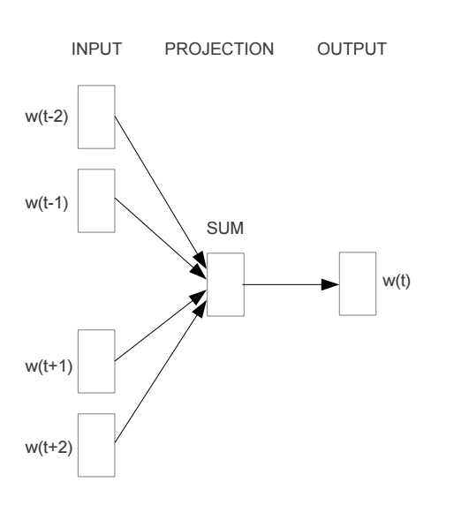
Train a neural network on this problem
https://arxiv.org/pdf/1301.3781v3.pdf

Slide 22
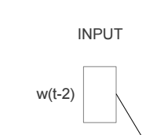
Encoding words
How can we input a “word” into a network?

Slide 23
“One-hot” encoding
For a vocabulary of V words, have V input nodes
All inputs are 0 except the for the one corresponding to the word
a
apple
…
V nodes
banana
…
zebra

Slide 24
“One-hot” encoding
For a vocabulary of V words, have V input nodes
All inputs are 0 except the for the one corresponding to the word
0
a
0
apple
banana
…
1
banana
…
0
zebra

Slide 25
“One-hot” encoding
For a vocabulary of V words, have V input nodes
All inputs are 0 except the for the one corresponding to the word
0
a
1
apple
apple
…
0
banana
…
0
zebra

Slide 26
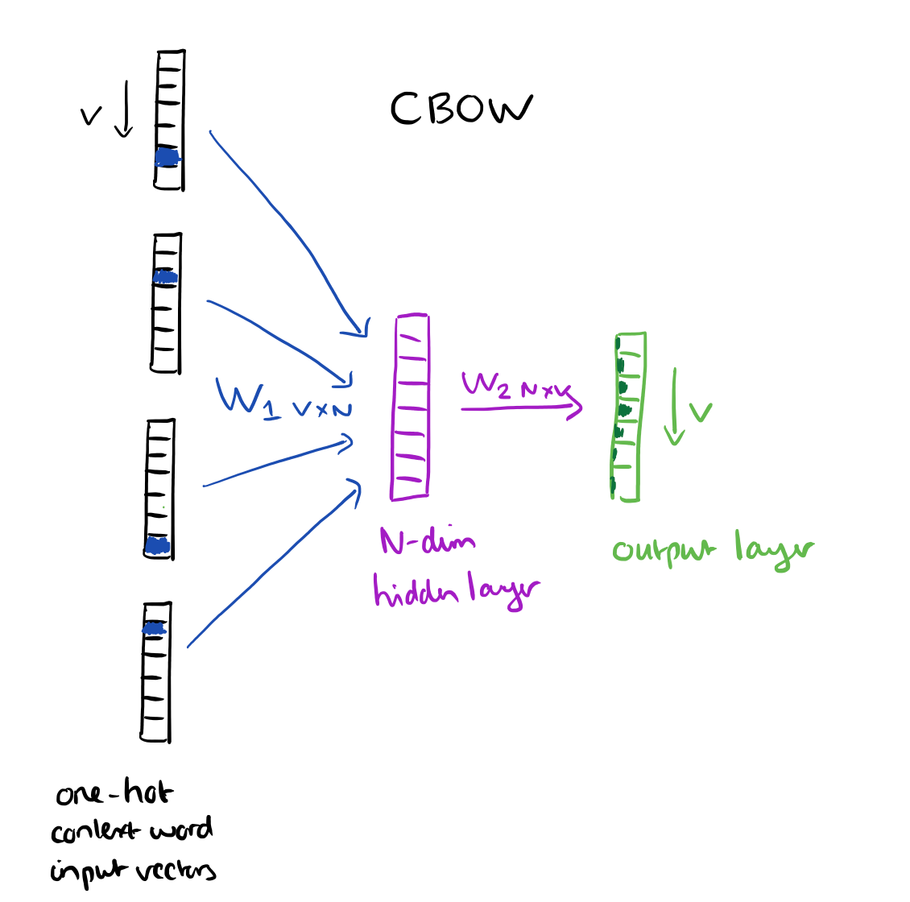
N = 100 to 1000
https://blog.acolyer.org/2016/04/21/the-amazing-power-of-word-vectors/

Slide 27
Another view
…
…
…
N hidden nodes
V input nodes
V output nodes

Slide 28
Training: backpropagation
___ like to eat
I ___ to eat bananas
I like ___ eat bananas with
I like to ___ bananas with cream
…
I
like
to
eat
…
…
…
…
N hidden nodes
V input nodes
V output nodes

Slide 29
Training: backpropagation
eat
I like to ___ bananas with cream
0
0
…
1
0
…
1
0
…
1
0
…
0
0
…
1
0
…
eat
I
…
like
…
…
to
N hidden nodes
V input nodes
V output nodes

Slide 30
Word representation
VxN weights
The weights for each word provide an N dimensional mapping of the word
Words that predict similarly should have similar weights
…
…
…
Why does this work?
N hidden nodes
V input nodes
V output nodes
Notes:
Words that have similar weights, will likely predict similar outputs, i.e., are likely to occur as context for the same words

Slide 31
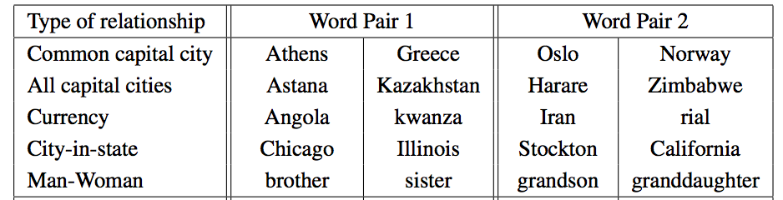
Results
vector(word1) – vector(word2) = vector(word3) - X
word1 is to word2 as word3 is to X

Slide 32

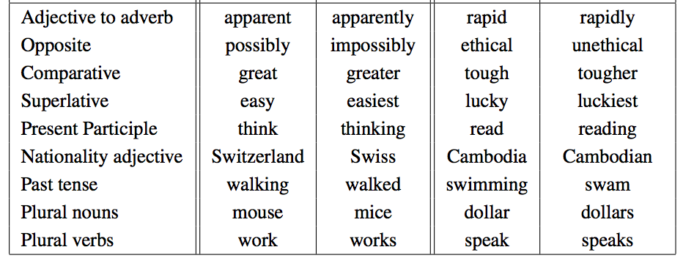
Results
vector(word1) – vector(word2) = vector(word3) - X
word1 is to word2 as word3 is to X

Slide 33
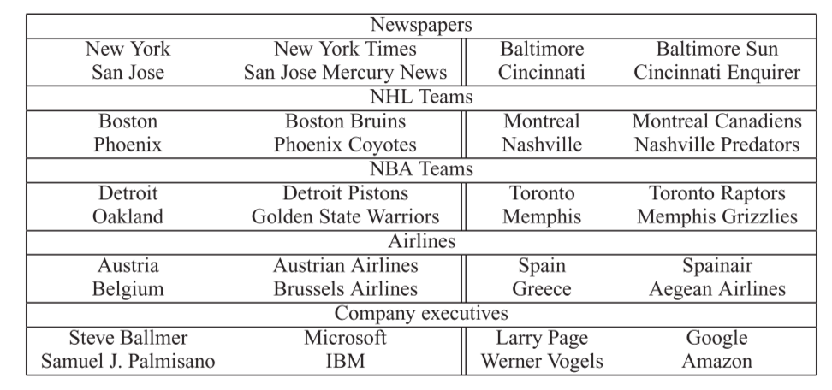
Results
vector(word1) – vector(word2) = vector(word3) - X
word1 is to word2 as word3 is to X

Slide 34
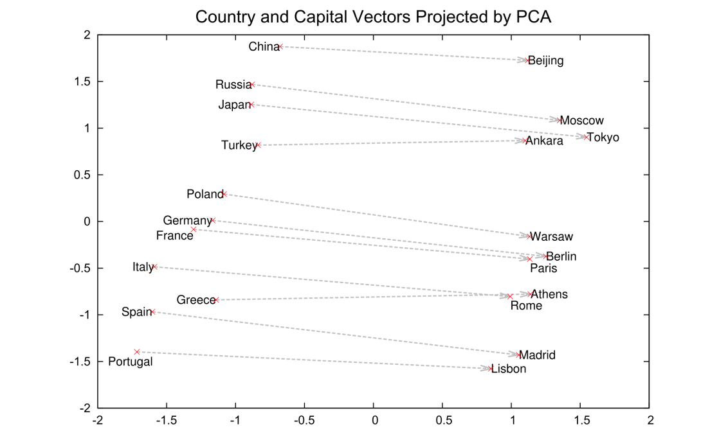
Results
2-Dimensional projection of the N-dimensional space

Slide 35
Visualized
https://projector.tensorflow.org/

Slide 36
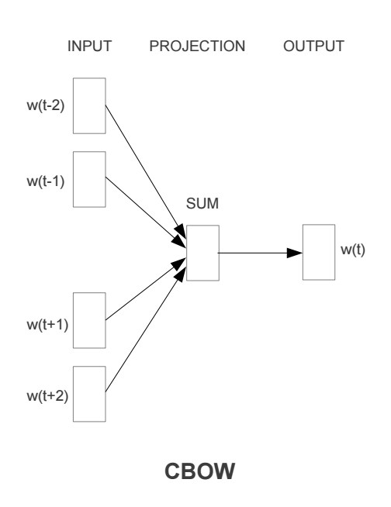
Continuous Bag Of Words

Slide 37
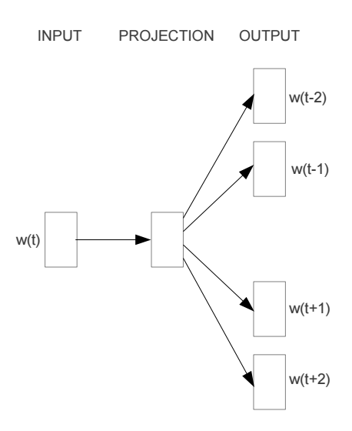
Other models: skip-gram

Slide 38
word2vec
A model for learning word representations from large amounts of data
Has become a popular pre-processing step for learning a more robust feature representation
Models like word2vec have also been incorporated into other learning approaches (e.g. translation tasks)

Slide 39
word2vec resources
https://blog.acolyer.org/2016/04/21/the-amazing-power-of-word-vectors/
https://code.google.com/archive/p/word2vec/
https://deeplearning4j.org/word2vec
https://arxiv.org/pdf/1301.3781v3.pdf

Slide 40
Image classification
Input: pixels of the image
Output: what’s in the image
Ideally: have some features that identify ”parts”
https://towardsdatascience.com/simple-introduction-to-convolutional-neural-networks-cdf8d3077bac

Slide 41
Challenge: many different features
https://towardsdatascience.com/simple-introduction-to-convolutional-neural-networks-cdf8d3077bac

Slide 42
Challenge: many different features
https://towardsdatascience.com/simple-introduction-to-convolutional-neural-networks-cdf8d3077bac

Slide 43
Image kernels

Slide 45
Idea: learn kernels

Slide 46
Traditional NN approach doesn’t work
https://towardsdatascience.com/simple-introduction-to-convolutional-neural-networks-cdf8d3077bac

Slide 47
Traditional NN approach doesn’t work
The information of image is the pixel
If we’re dealing with a 512x512 RGB image, we have 512x512x3 = 786,432 inputs
How many weights will we have with 5 hidden nodes?
For example, a 512x512 RGB image has 512x512x3 = 786,432 and therefore 786,432 weights in the next layer per neuron

Slide 48
Traditional NN approach doesn’t work
The information of image is the pixel
If we’re dealing with a 512x512 RGB image, we have 512x512x3 = 786,432 inputs
786,432 weights per neuron = ~4M weights!

Slide 49
Convolutional Neural Networks (CNNs)
Height
We’ll draw layers as blocks of nodes/inputs, e.g., 512 x 512 x 3
Width
Depth (Channel)

Slide 50
Locally connected
image features are usually local
reduce the fully-connected network to locally-connected network.
For example, if we set window size 5, we only need 5x5x3 = 75

Slide 51
fully connected -> locally connected
Input layer
Hidden layer

Slide 52
hidden nodes
number of hidden nodes
Input layer
Hidden layer

Slide 53
apply across entire image
number of hidden nodes
Input layer
Hidden layer

Slide 54
apply across entire image
number of hidden nodes
Input layer
Hidden layer
How many weighs assuming: 512x512x3 images,
5 x 5 x 3 locally connected, and 5 hidden nodes?

Slide 55
Too many weights!
Despite only locally-connected, there are still too many weights
512x512x5 neurons in the next layer, we have 5x5x3 local connections = 98 million weights
Notes:
This allows us to focus on particular regions, but we now have too many weights.

Slide 56
Share weights:
All weights to a given hidden node are the same for the locally-connected edges
During classification, we treat it like we have different edges, just with the same weight
During training, we update the weights as normal except we update the same weights for a given hidden node
Solves the positional issue!

Slide 57
Share weights
We share parameter in the same depth.
Input layer
Hidden layer

Slide 58
Parameter sharing
We share parameter in the same depth
Now we only have 75x5=375 weights
We call these layers “convolution layers”.
What is learned can be considered as the convolution filters (like a kernel)

Slide 59
Pool layers
Convolution layers are often followed by pool layers
Reduce the weights without losing too much information
1 | 2 | 5 | 6
3 | 4 | 2 | 8
3 | 4 | 4 | 2
1 | 5 | 6 | 3
Max pooling
4 | 8
5 | 6
Single depth slice

Slide 60
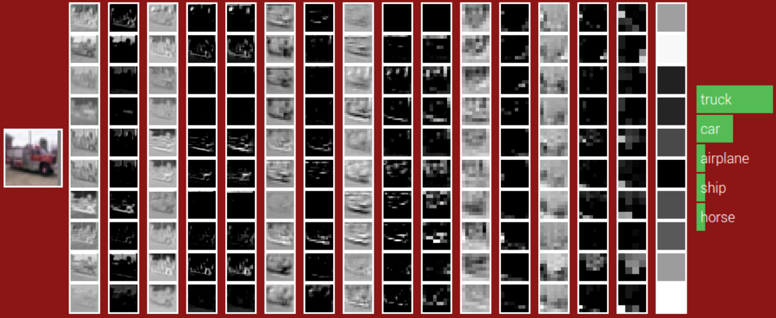
POOL
POOL
POOL
ReLU
ReLU
ReLU
ReLU
ReLU
ReLU
CONV
CONV
CONV
CONV
CONV
CONV
Fully-connected
32x32
Weights:
280
910
910
910
910
910
1600
Size:
16x16
8x8
4x4

Slide 61
Another example
https://adamharley.com/nn_vis/

